Slide 1

SMS & Email Spam Classifier Subject: Data 606(Capstone Project)
Professor: Chaojie Wang
Precentor: DUrga SIva Sai Varma RUdraraju

Slide 2

1.Introduction
The objective of the Email Spam Classifier and SMS Spam Classifier projects is to develop machine learning models and algorithms that can automatically categorize emails and texts as spam (unwanted, unsolicited) or legitimate (non-spam) depending on their content and features. The main objective is to build a platform that classifies out undesirable messages, which will enhance email and messaging for users.

Slide 3
Agenda
Introduction
Data Description
Exploratory Data Analysis (EDA)
Model Training
Prediction
Web Application
Conclusion

Slide 4
2.Data Description
Data Sources: https://www.kaggle.com/datasets/uciml/sms-spam-collection-dataset?
Data Size: Approximately 503 KB
Data Description: The "spam.csv" dataset contains SMS messages or emails, particularly focusing on spam classification
Dataset Size: Number of Rows : 5572 Number of Columns : 2
Data Types: v1 : Categorical v2 : Text data

Slide 5
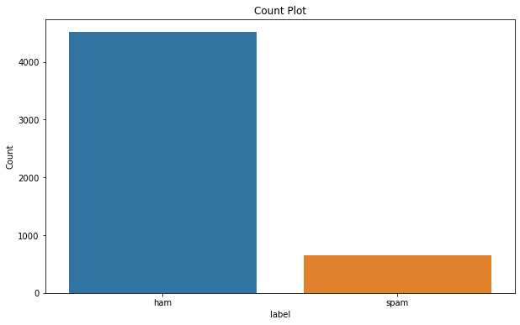
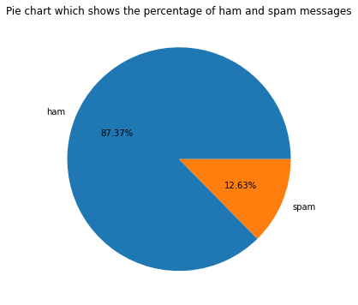
3.EXPLORATORY DATA ANALYSIS
The number of Ham and the number of Spam messages are being counted​
Count plot: The below count plot represents the count vs label graph​
Pie Chart: The pie chart represents the percentage of Ham and Spam messages that are present in the data

Slide 6
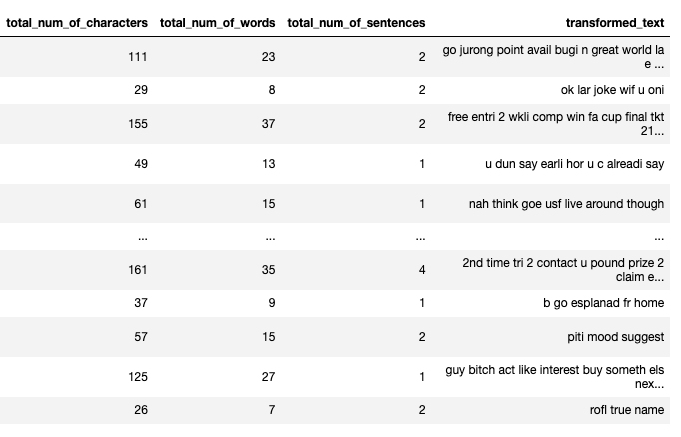
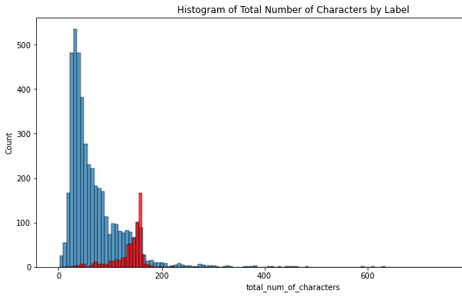
3.EXPLORATORY DATA ANALYSIS
NLTK stands for Natural Language Toolkit. It is used for working with human language data, particularly for tasks related to natural language processing (NLP). NLTK provides tools, resources, and libraries for a wide range of NLP tasks, including tokenization, stemming, tagging, parsing, semantic reasoning, and more

Slide 7
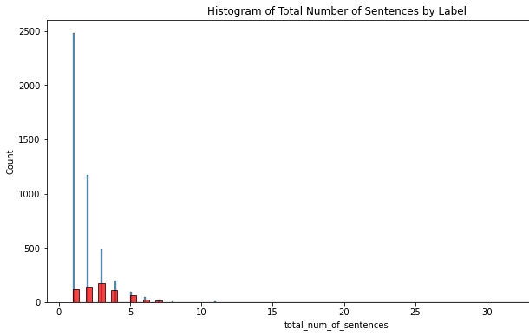

3.EXPLORATORY DATA ANALYSIS
Plotted the graphs for Histogram of the Total Number of Characters by Label, Histogram of the Total Number of Words by Label, Histogram of Total Number of Sentences by Label and Heatmap of number of characters, number of words, number of sentences columns

Slide 8
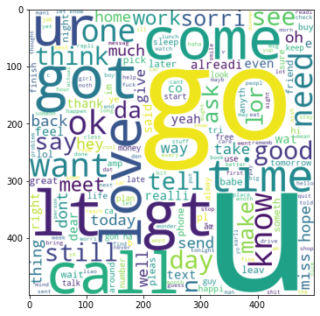
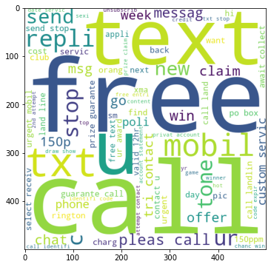
3.EXPLORATORY DATA ANALYSIS
Displaying the wordcloud is the graphical representation of word frequency that give greater preference to words that appear more frequently in a source text. Using the wordcloud library I am creating two wordclouds one which shows spam words and the other which shows non-spam words.

Slide 9
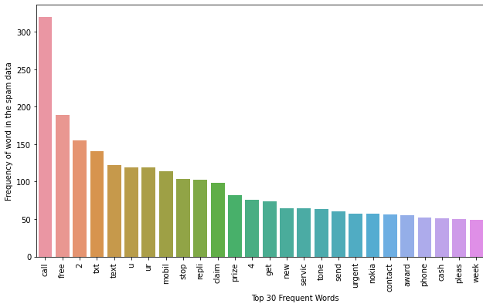
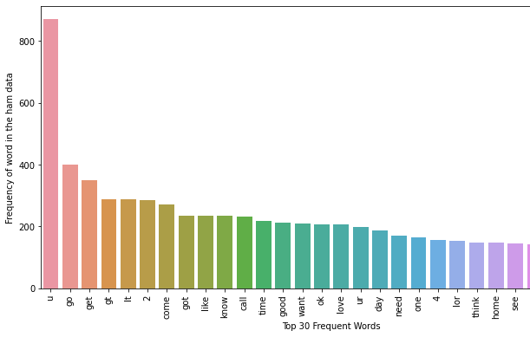
3.EXPLORATORY DATA ANALYSIS
Created a list of spam and ham words from the data and found the Total spam words in the data and Total ham words in the data
Plotted the Bar plots for the common words in the spam & ham text: The bar plot represents the Top 30 Frequent Words V/s Frequency of word in the spam & ham data.

Slide 10
4.MODEL TRAINING
How will you train the models?
Train vs test split: 80% of the data for training the models and 20% for testing
Python packages to be used: scikit-learn for building, training, and evaluating machine learning models.
The development environments: Jupyter Notebook environment with access to crucial tools and resources for data science and machine learning
How will you measure and compare the performance of the models? : Accuracy, Precision and Confusion_matrix

Slide 11
4.1 Models Used for Machine Learning
GaussianNB Scores
Accuracy Score: 0.86
Precision Score: 0.5
MultinomialNB Scores
Accuracy Score: 0.97
Precision Score: 1.0
BernoulliNB Scores
Accuracy Score: 0.98
Precision Score: 0.99
Initially I will be using Navie bayes model as we know that for text based dataset Navie bayes works well later other models will also be used.

Slide 12
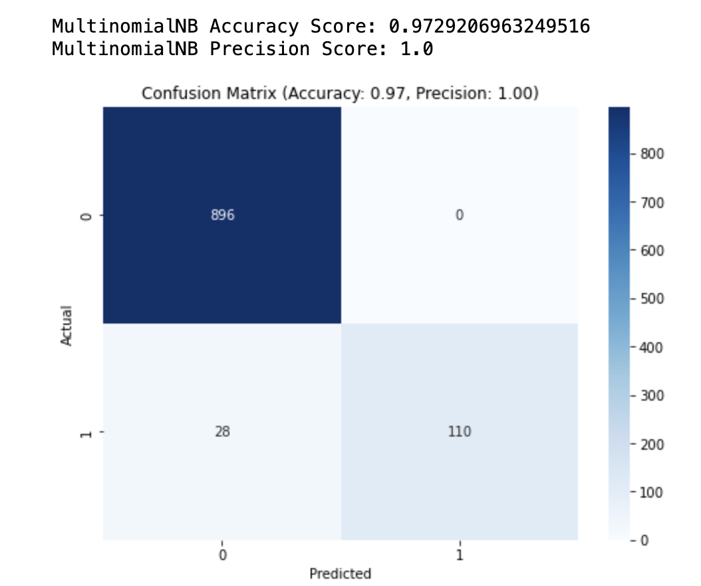
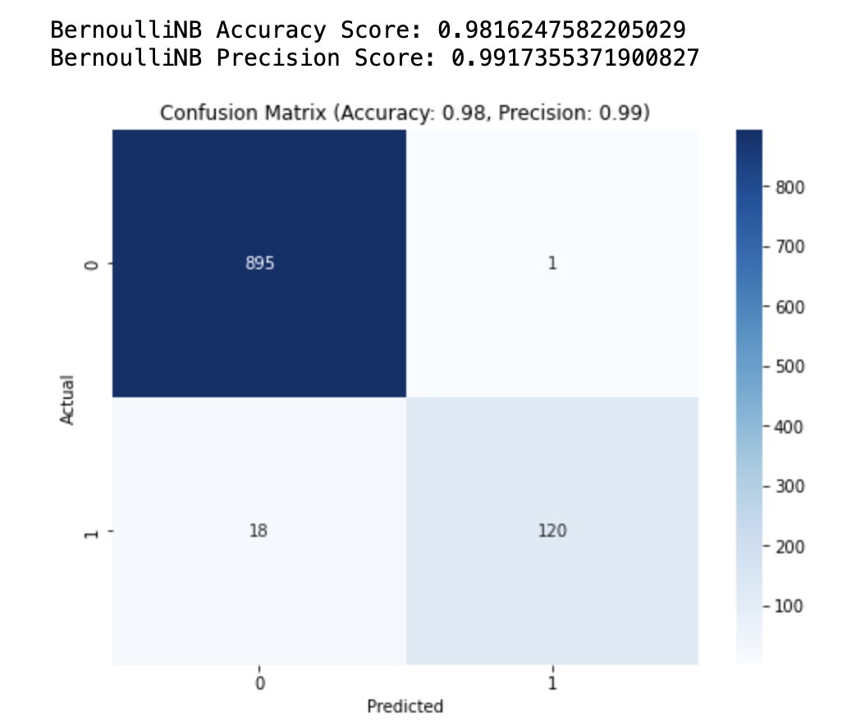
4.1 Models Used for Machine Learning
Confusion matrix for both MultinomialNB and BernoulliNB

Slide 13
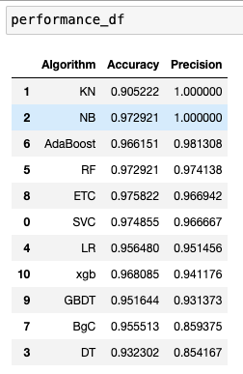
4.1 Models Used for Machine Learning
Here we can see the comparison of the performance of all the models that have been used. From the table we can say that Navie bayes gives the best precision and accuracy.

Slide 14
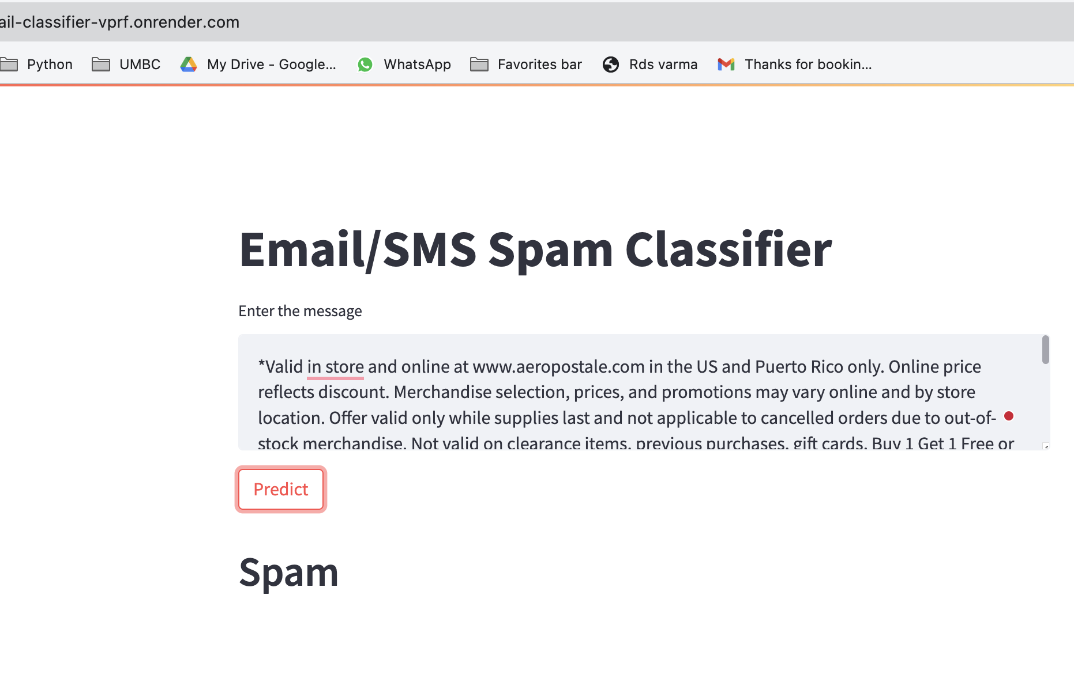
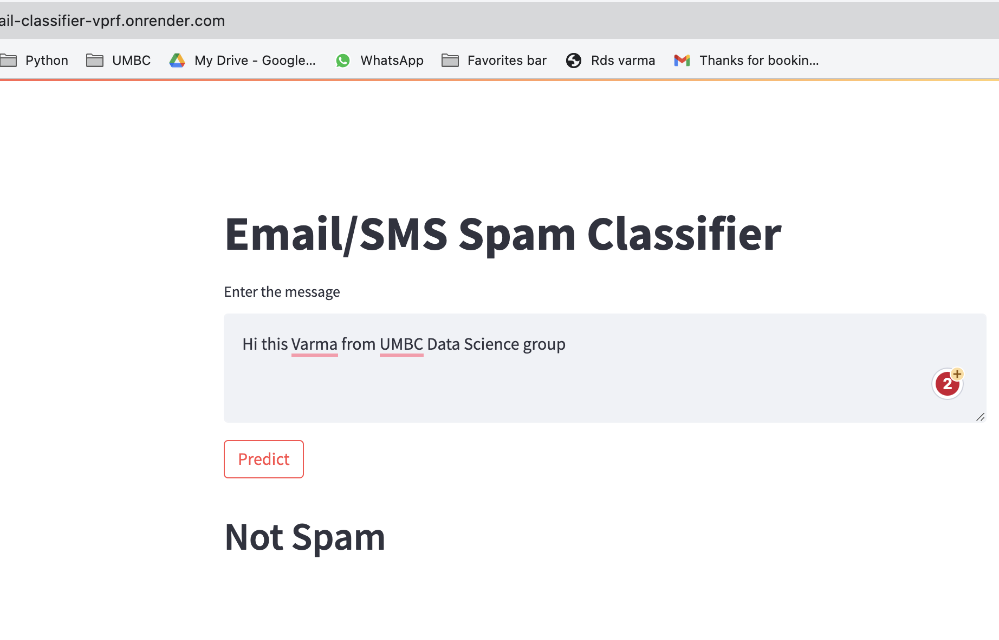
5. Web application
I have created a web application using Streamlit. This is a user friendly interface where a user can just give the text and check if massage they have received is spam or not spam.
https://sms-email-classifier-vprf.onrender.com/

Slide 15
6. Conclusion
Successfully conducted the training and testing phases of the project.
Employed a machine learning model for accurate prediction of whether a message is spam or not
Implemented a user-friendly interface for seamless interaction.
Users can input a message into the text box to instantly check its spam classification.
Notes:
In this project, I have successfully completed the training and testing phases, employing a machine learning model to predict whether a message is spam or not. Additionally, I have implemented a user-friendly interface, allowing any user to input a message into the text box and check its spam classification

Slide 16

Thank you !!! Any Questions ?

